Slide 1
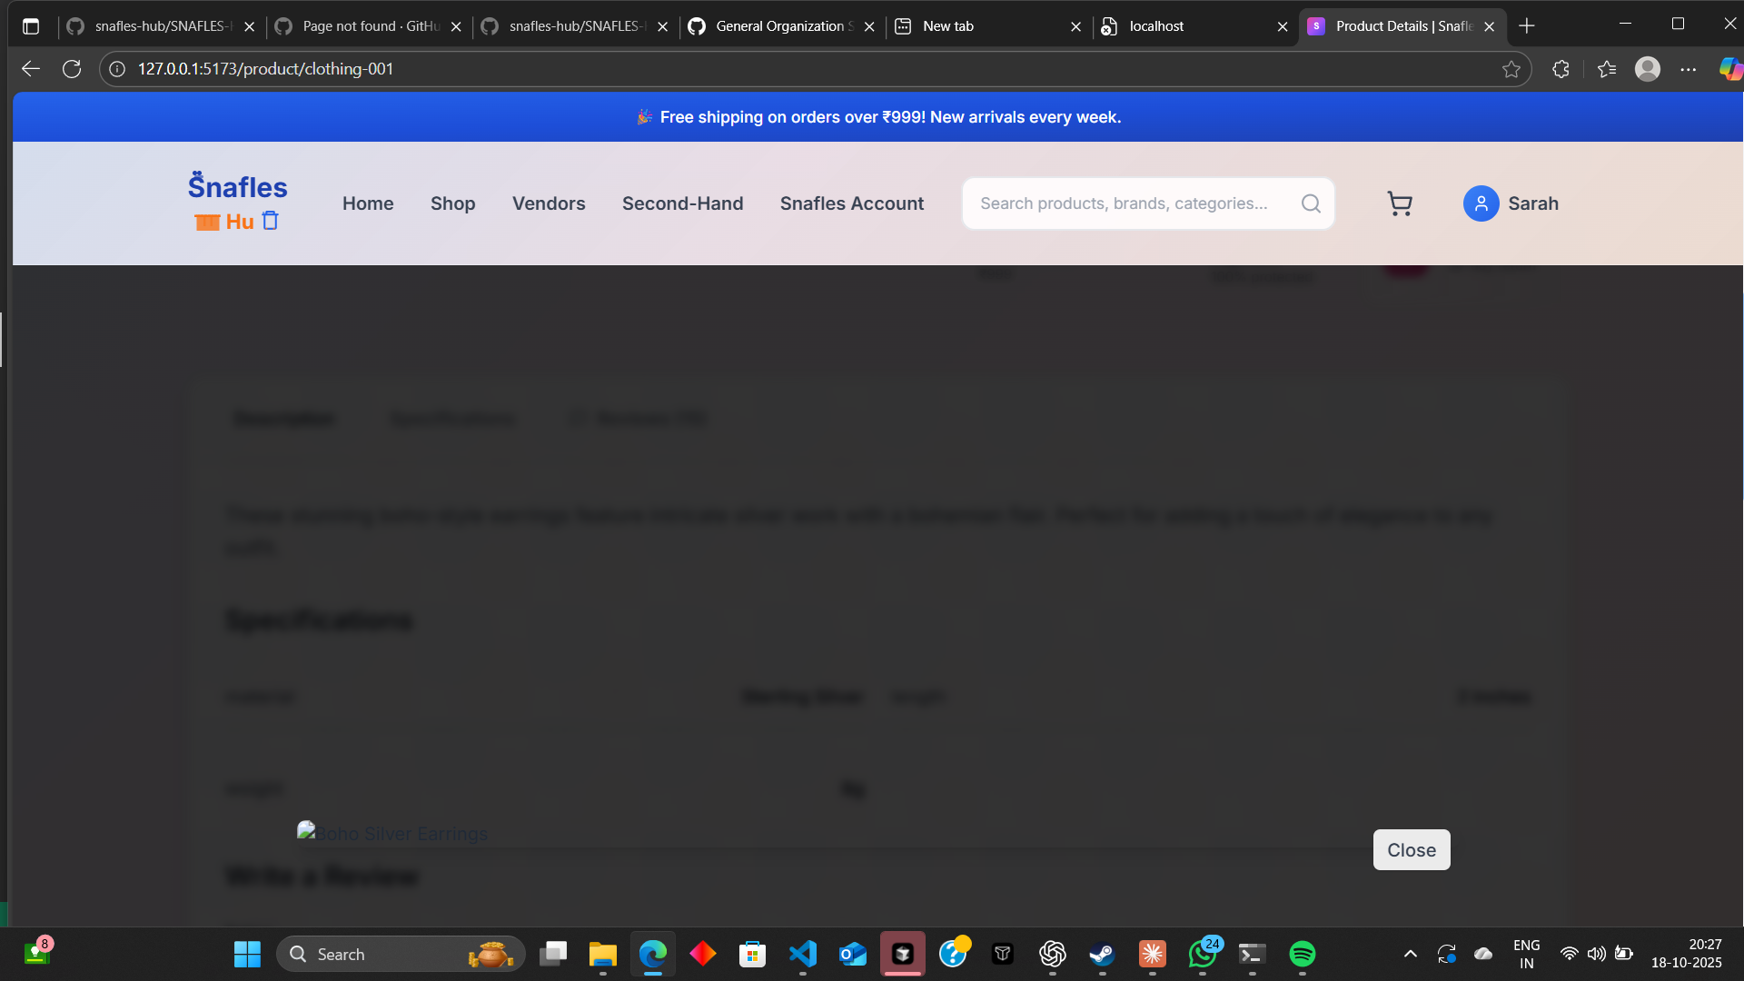

1 IN SHOP Login Modal Rendering Issue
The login modal is currently not rendering or animating as intended. The interface feels unresponsive and the display behavior isn’t smooth. Transitions, positioning, and overall play of the modal appear broken, leading to a poor visual experience. Additionally, the error messaging within the login component isn’t displaying properly, making it difficult to diagnose failed login attempts. Further review of the modal’s animation triggers and rendering flow is needed to ensure consistent performance and accurate error feedbac

Slide 2
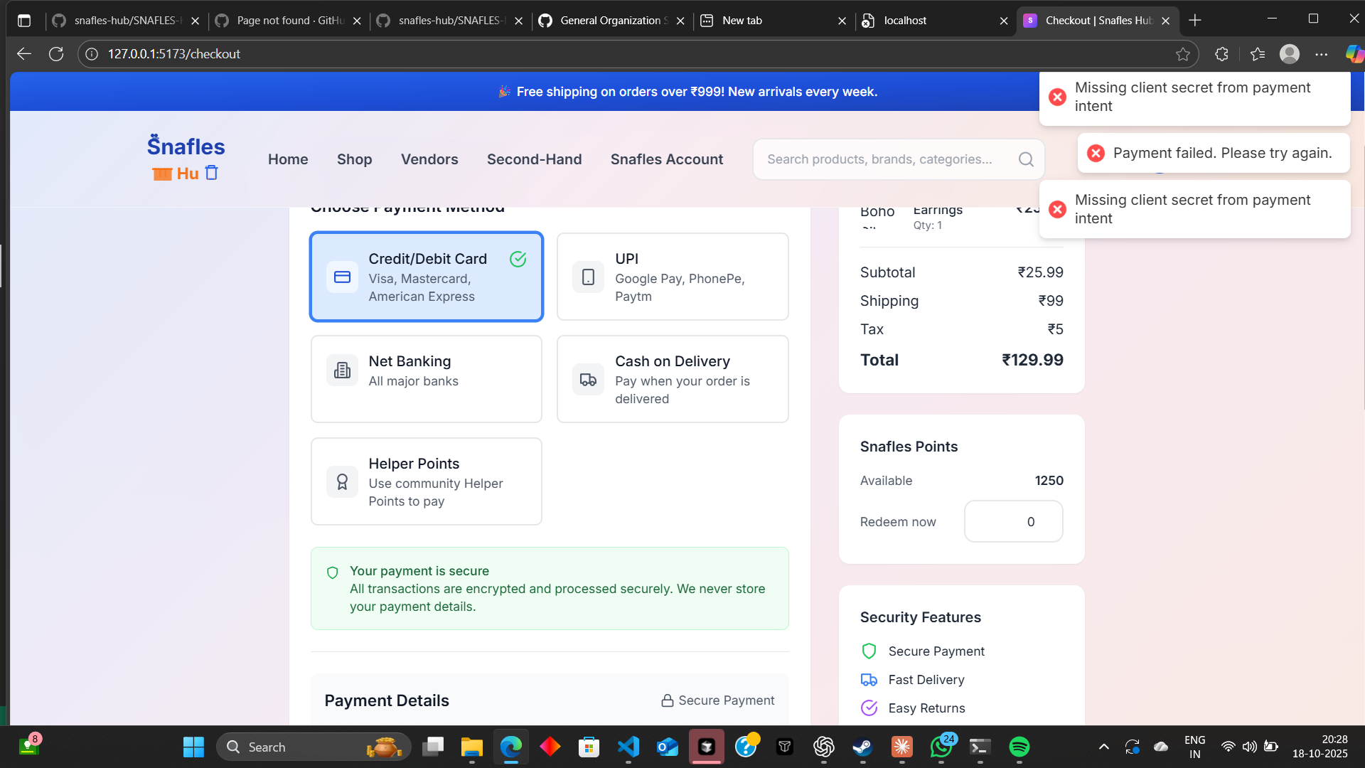
2.Checkout and Payment Flow Issues
The checkout process is currently not functioning as expected. The system displays repeated payment errors such as “Missing client secret from payment intent” and “Payment failed, please try again.” Additionally, the payment flow feels inconsistent, with both a “Place Order” and a “Pay” button appearing simultaneously, which confuses users and disrupts the transaction process.
The layout and button alignment also need refinement to provide a smooth, logical flow — users should be able to clearly understand when an order is placed and when payment is processed. A unified, error-free payment sequence is required for better reliability and user trust.

Slide 3
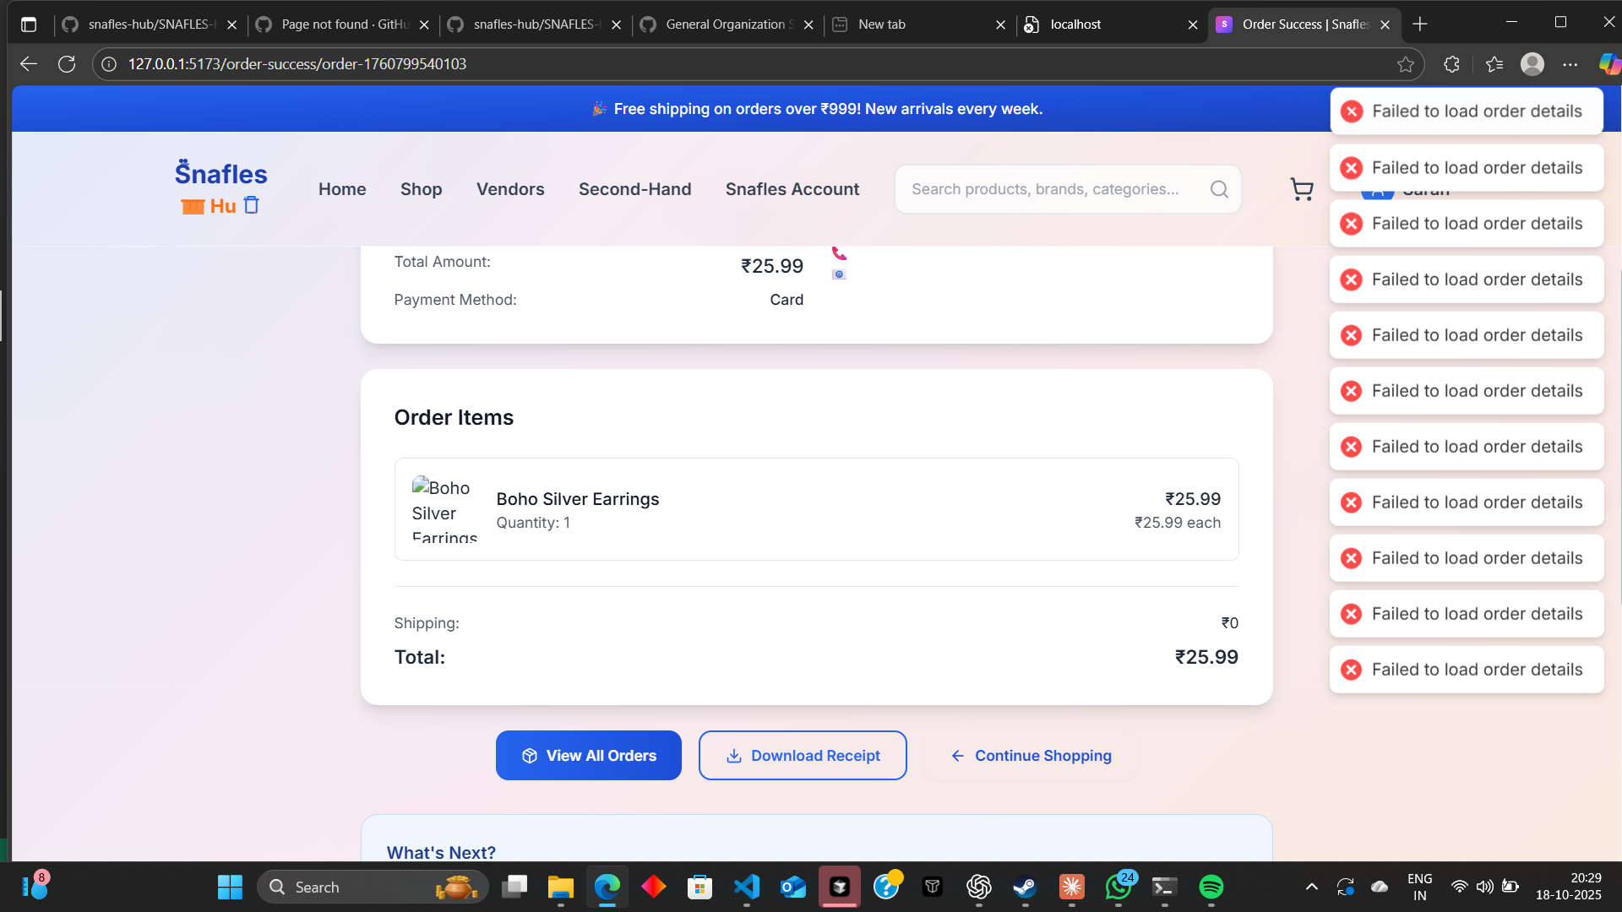
3.Order Success Page Glitch and Data Loading Issue
The order success page is currently unstable and displaying multiple “Failed to load order details” error pop-ups in quick succession. This creates a blinking and spam-like effect that disrupts the user experience after checkout. The page continuously attempts to reload or fetch order information but fails to do so, making it appear broken even when the order is successfully completed.
The layout also becomes visually cluttered due to repeated error messages. The flow should be streamlined — once the order is confirmed, a clean summary with stable order details should load without repetitive refreshes or visual flicker. A proper state-handling mechanism is needed to ensure that order data loads once, displays smoothly, and confirms success with clarity and stability.

Slide 4
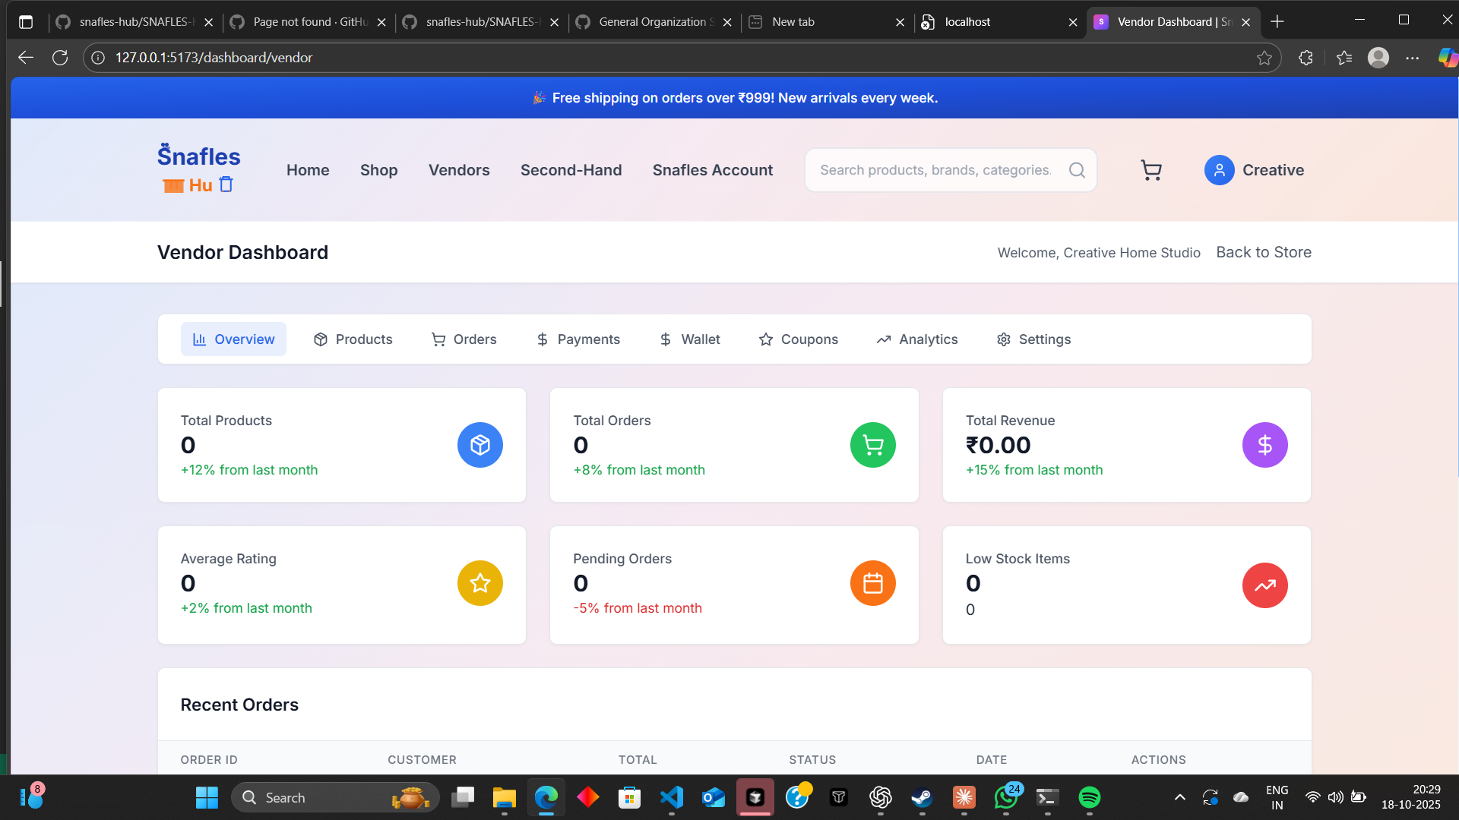
Vendor Dashboard Functionality and Routing Issues
The vendor dashboard is currently facing major functionality and routing problems. Core sections such as “Add Product,” “Orders,” “Payments,” and “Analytics” are either unresponsive or improperly linked, causing a disrupted user experience. Navigation between routes is inconsistent, and certain features fail to load or update as expected.
The analytics panel also needs refinement — data visualization, key metrics, and layout alignment should be improved for better clarity and usability. Vendor login, product management, and route connections require a complete review and restructuring to ensure smooth operation. Overall, the entire vendor dashboard needs to be stabilized and properly configured for consistent performance across all modules.

Slide 5
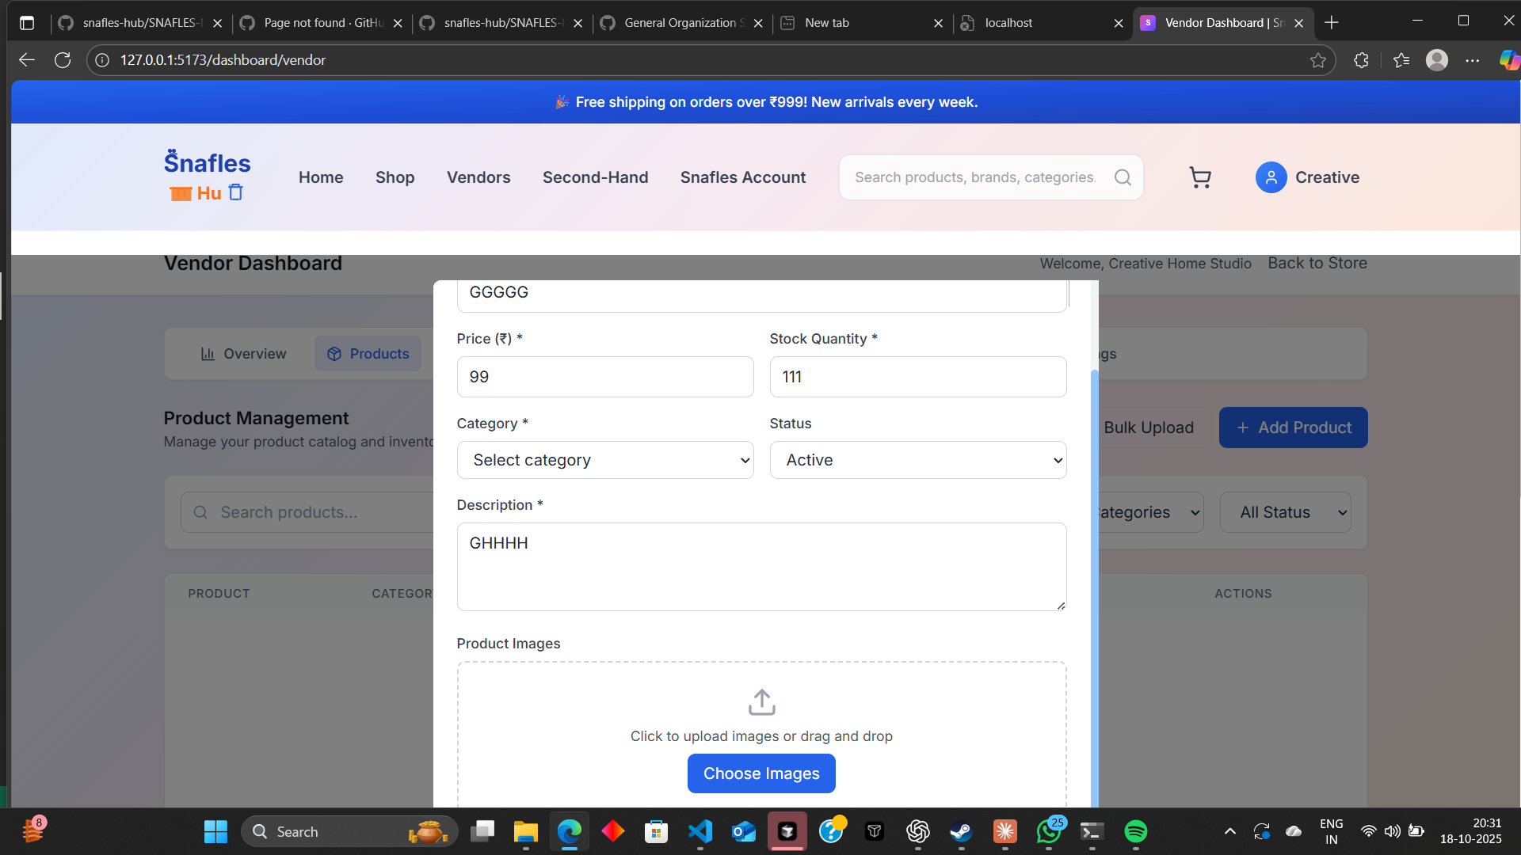
Vendor Product Management and UI Alignment Issues
The product management section in the vendor dashboard is currently misaligned and not functioning as intended. Buttons such as “Add Product,” “Choose Images,” and related actions are unresponsive or improperly positioned, leading to a cluttered and confusing user interface. Input fields and dropdown menus also appear inconsistent, breaking the overall layout.
The entire vendor product module needs to be fixed for smoother usability — elements should align neatly, buttons should respond instantly, and all form actions (like uploading images or saving products) must work reliably. Improving the layout structure and ensuring proper route linkage will create a clean, responsive, and intuitive experience for vendors managing their products.

Slide 6
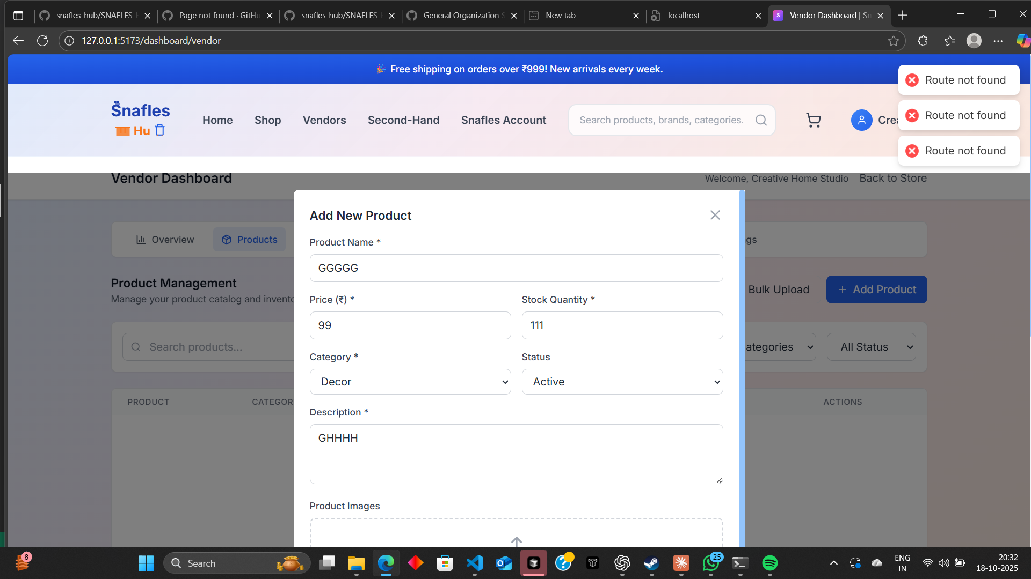
Route Not Found After “Add Product” Action
After completing the “Add Product” flow in the vendor dashboard (filling details and proceeding), the application redirects to a page that returns “Route Not Found.” This breaks the workflow immediately after submission and leaves the vendor unsure if the product was saved. The issue appears during post-submission navigation, suggesting incorrect or missing route mapping for the success/detail page, or an invalid redirect path. The experience needs a stable, valid route handoff so that, after adding a product, the user lands on a clear confirmation or the product detail/list page without errors.

Slide 7
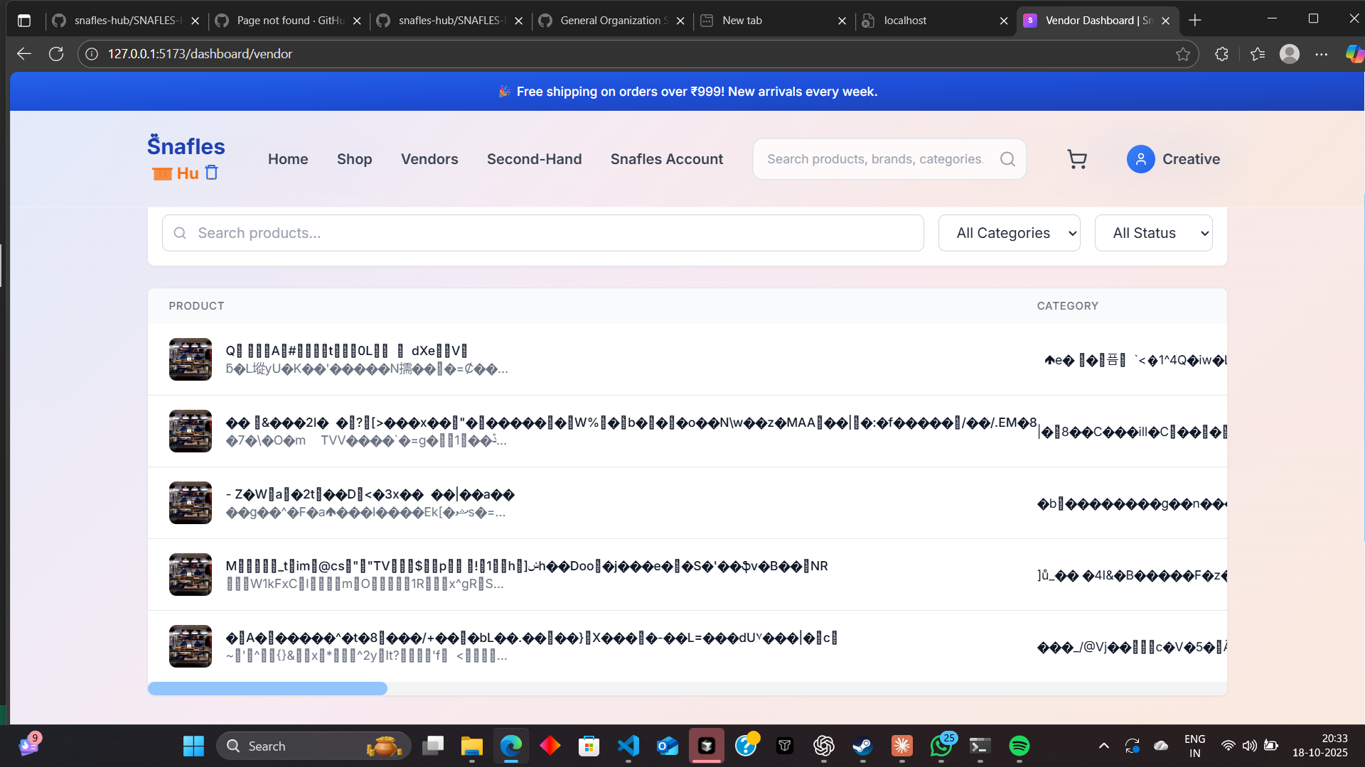
Bulk Upload (“ADD Bulk”) Button Malfunction
The “AddBulk” button does not trigger any action or leads to incomplete behavior. After clicking, the UI shows no clear progress or result, and in some cases the page fails to update, leaving the user unsure whether products were uploaded. The lack of feedback and completion state interrupts the vendor workflow and prevents batch product creation.

Slide 8
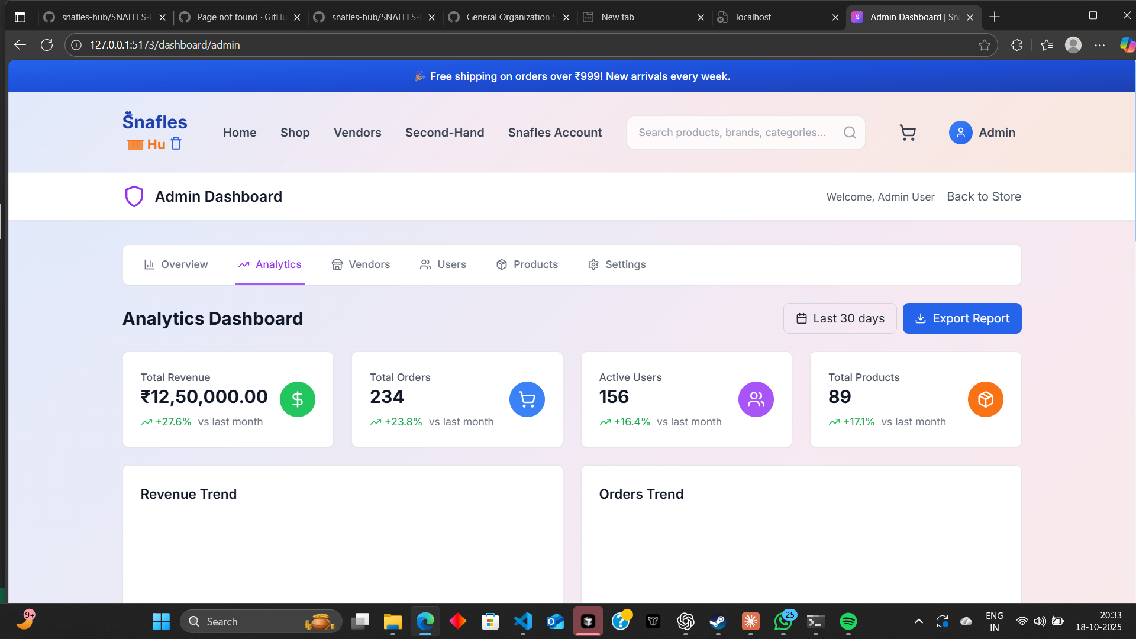
Admin Export Report Button Not Functioning
The “Export Report” button in the admin section is unresponsive and fails to trigger any export action. When clicked, no download starts, and no visual feedback (such as a loading state or success prompt) appears. This creates confusion for administrators attempting to generate and retrieve reports.
The issue affects key admin workflows, preventing data export and analysis. The export functionality should initiate properly, generate the report file (CSV, PDF, or XLSX), and provide confirmation once the download is ready. Visual indicators like progress or success messages would also improve clarity and usability.

Slide 9
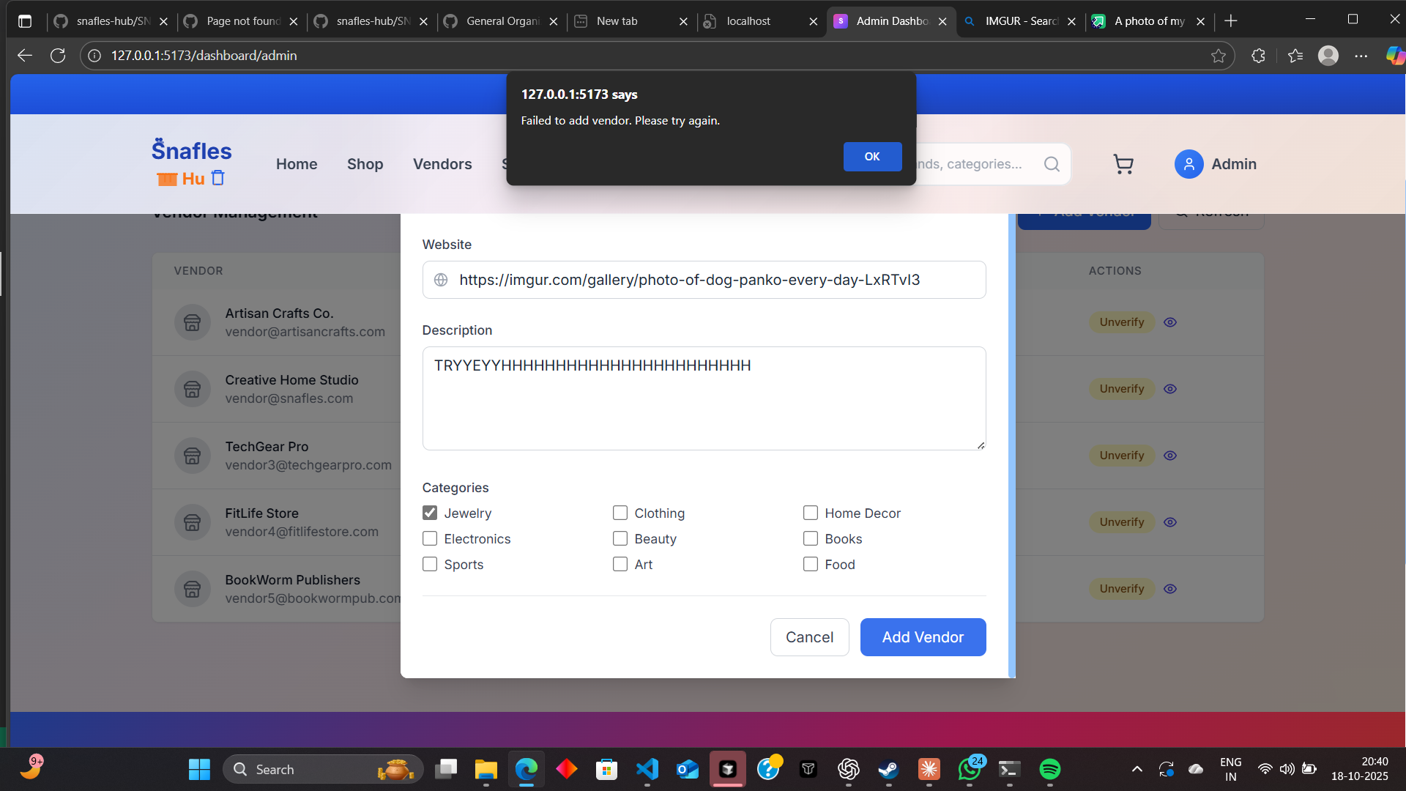
Vendor Creation Fails in Admin Panel
After entering all vendor details in the admin panel, the “Add Vendor” action does not complete successfully. The form appears to submit, but the vendor record is not created and no clear confirmation is shown. This blocks onboarding and prevents new vendors from being added to the system.

Slide 10
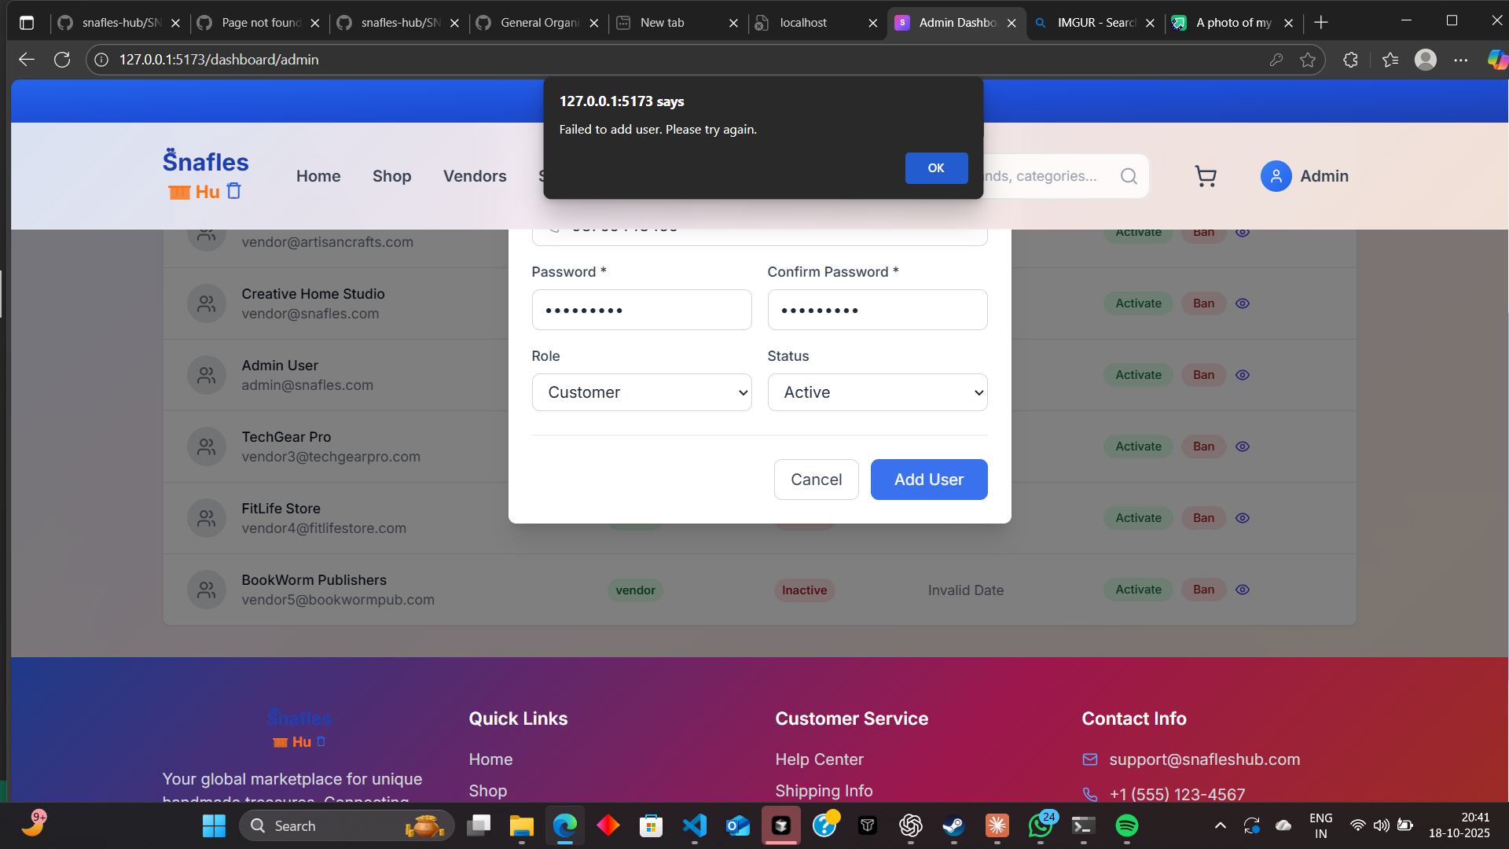
Admin “Add User” Function Not Working
When attempting to add a new user through the admin panel, the action fails and displays an error message instead of successfully creating the user. Even after filling in all required details and assigning the role (e.g., “Admin”), the form does not process correctly, and no confirmation or user record appears in the system.
This failure disrupts administrative workflows and prevents new users or admins from being added. The issue likely stems from incorrect role assignment handling or backend validation errors. The process should properly validate input, assign roles, and display clear success or error messages so administrators can manage user accounts reliably.

Slide 11
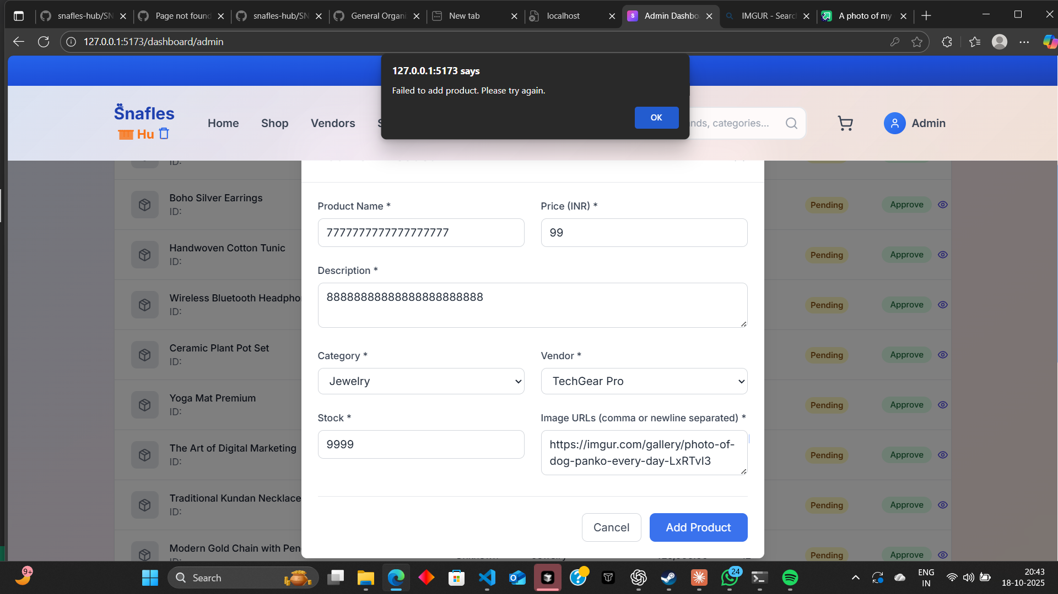
Admin “Add Product” Function Not Working
The “Add Product” feature in the admin panel is not functioning correctly. After entering all required product details and attempting to submit, the process fails to complete and no product is added to the catalog. The page either remains static or displays an error message without proper context, leaving the user uncertain about the submission status.
This issue prevents administrators from adding or updating products, disrupting catalog management and vendor operations. The form validation, route handling, and post-submission logic need to be reviewed to ensure that product data is correctly processed, saved to the database, and confirmed with a clear success message or redirect.

Slide 12
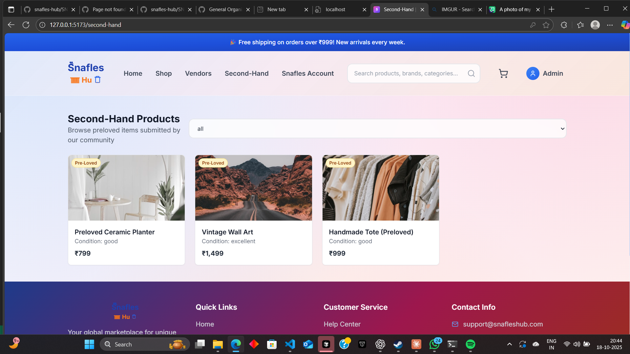
Pre-Loved Product Page Not Rendering Properly
The Pre-Loved (resale) product page is not functioning as expected. Products fail to load, and the page frequently displays messages such as “Product not loaded” or similar errors. Incomplete rendering and missing product data make the page appear broken and prevent users from viewing available pre-owned listings.
This issue disrupts the browsing and buying experience for customers interested in secondhand items. The product fetching and rendering logic should be reviewed to ensure that all pre-loved items load consistently, images and details appear correctly, and the layout remains stable. A smooth, fully populated display will improve trust and engagement in the resale section.

Slide 13
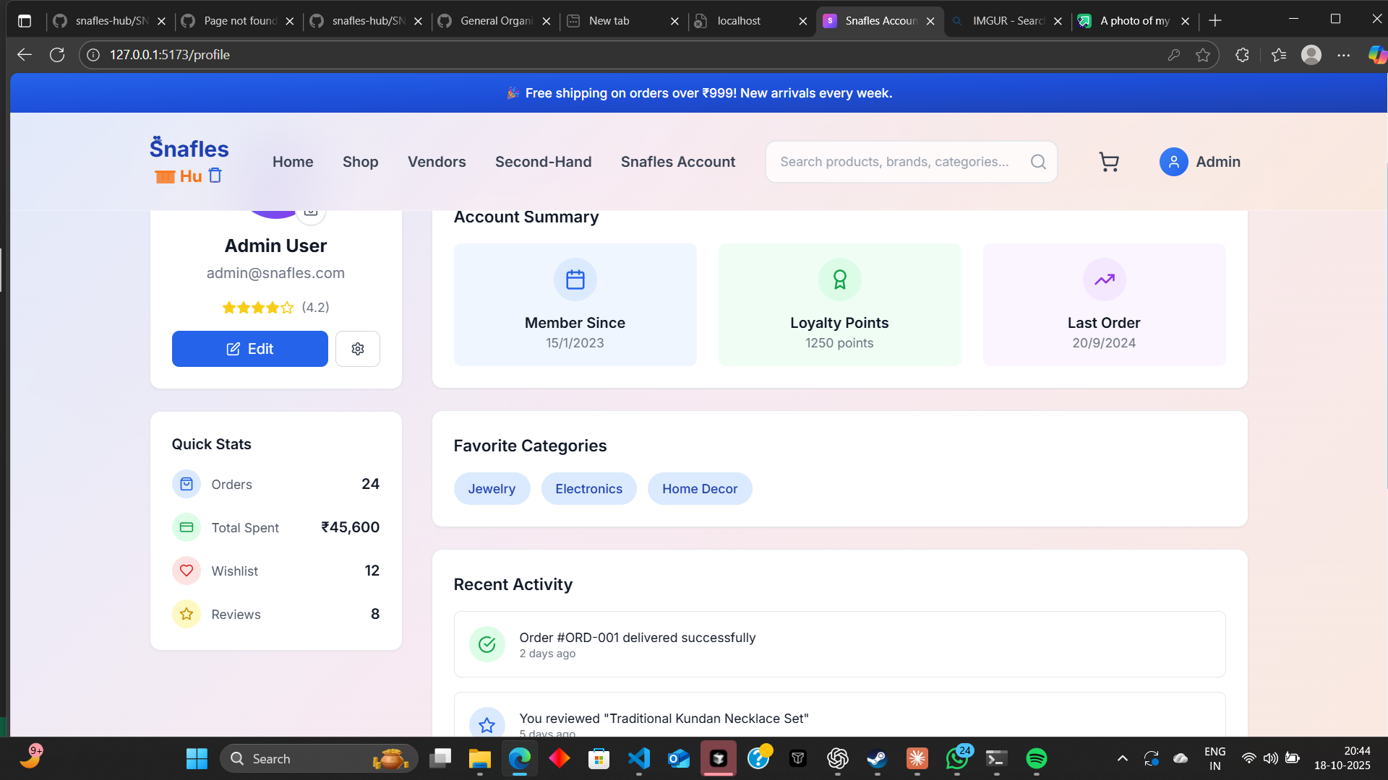
Admin Role Display and Access Flow Issue
The site currently identifies admin accounts as regular users, causing role-based access confusion and functionality errors. Admin users are shown user-level interfaces and do not have access to key admin tools or management options. This incorrect role mapping breaks the expected control hierarchy and limits administrative capabilities.
The role flow needs to be corrected so that admin accounts are distinctly recognized and routed to the proper admin dashboard. The interface should dynamically load the correct permissions, features, and navigation panels for each role. Ensuring proper role separation will maintain platform security, streamline workflows, and deliver a consistent user experience.

Slide 14
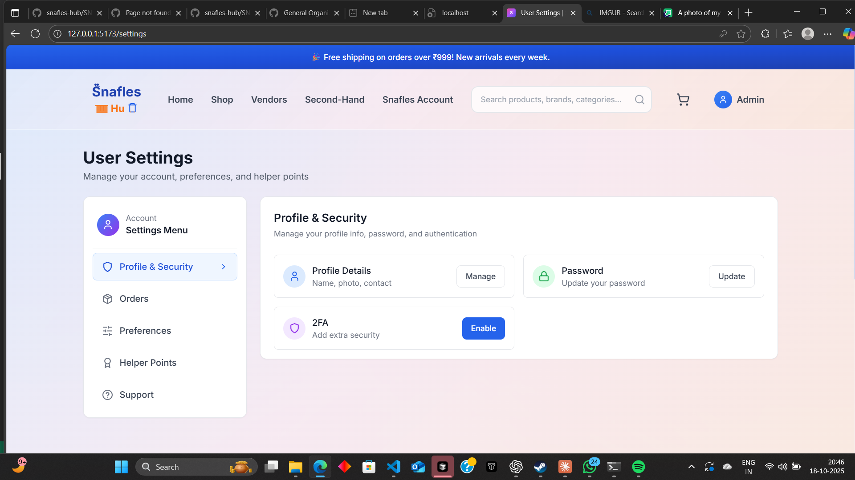
User Journal Settings Not Functioning
The user journal settings feature is currently unresponsive and not saving user preferences as expected. Attempts to update journal entries, toggle visibility, or adjust personal settings do not take effect, leaving the feature non-functional. This issue disrupts personalization and data tracking for users who rely on the journal for activity management.
A review of the settings logic and backend synchronization is required to ensure that user updates are properly captured, saved, and displayed in real time. The interface should also provide confirmation feedback when changes are applied successfully.

Slide 15
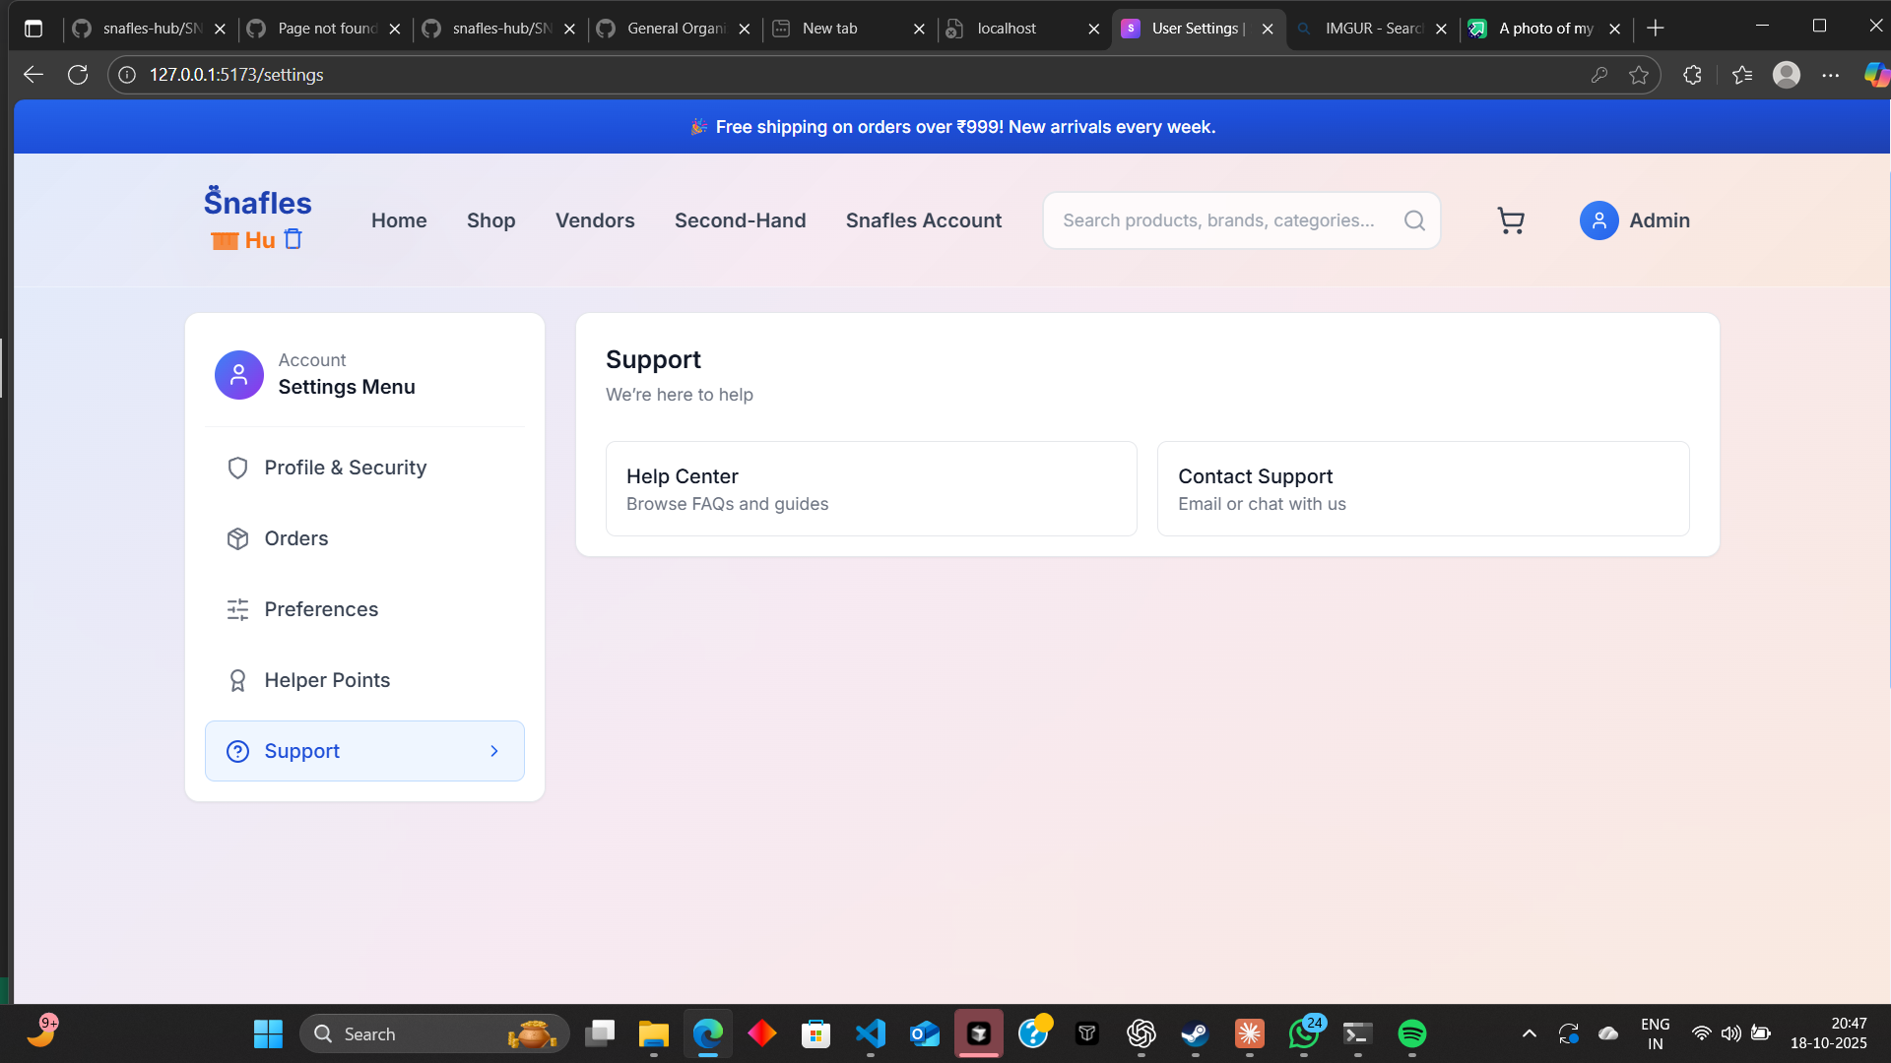
Customer Support Enhancement Needed
The platform’s customer support system requires refinement to improve response times, usability, and accessibility. Users face difficulty in finding help resources or submitting support tickets effectively. The current setup lacks structured escalation paths and clear communication feedback.
An improved support experience should include an intuitive help center, live chat or ticket-based communication, and clear progress tracking for user queries. Refining these areas will build trust, ensure quicker issue resolution, and provide users with a smoother, more dependable support experience.

Slide 16
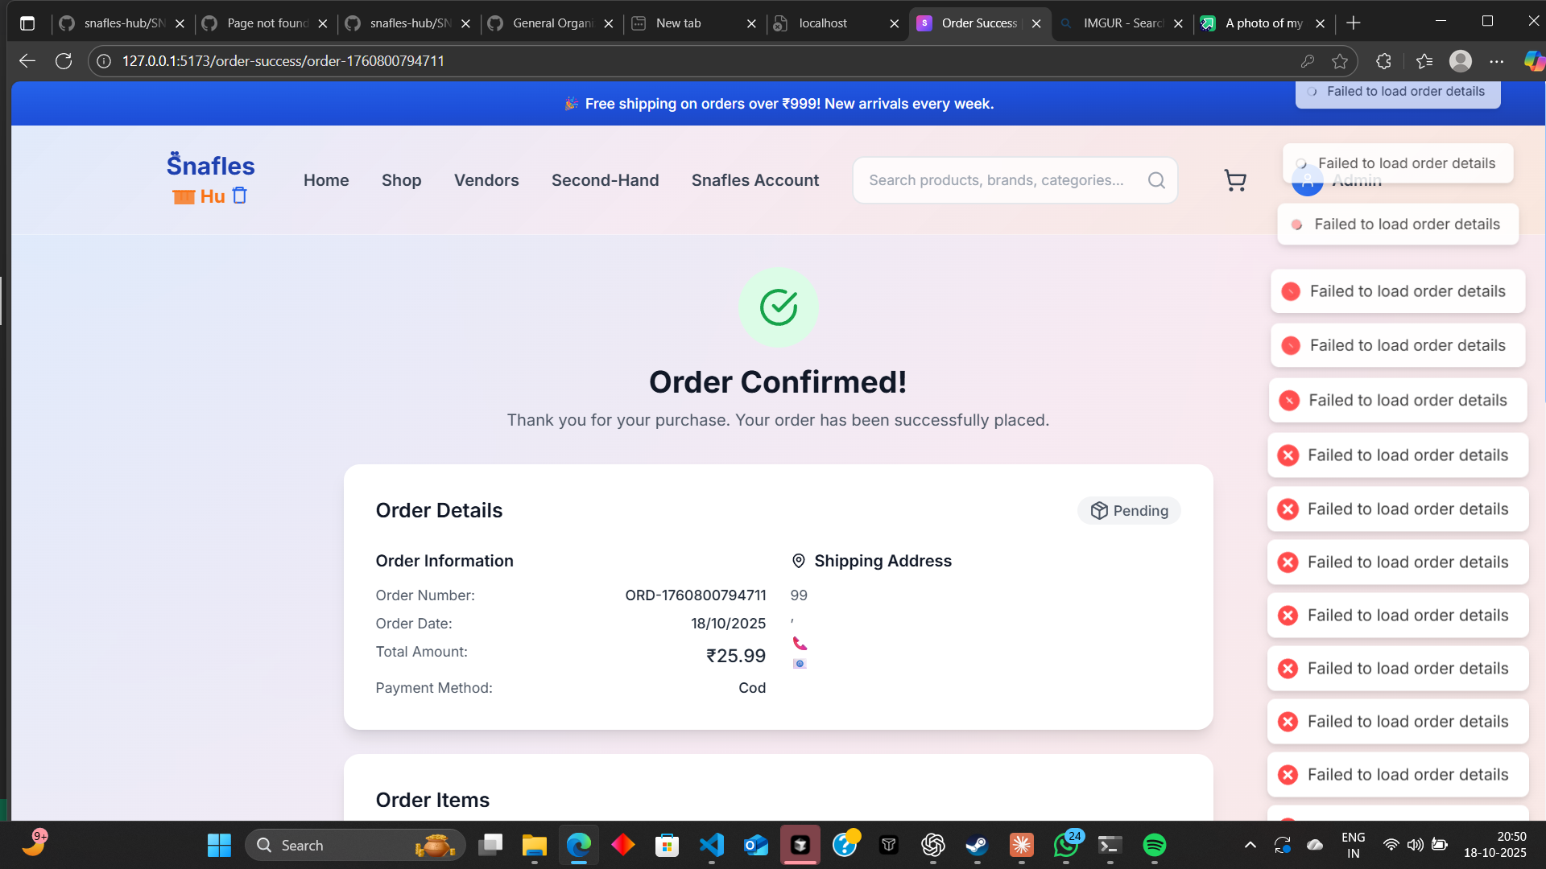
Order Confirmation Animation and Data Loading Conflict
After completing an order, the front-end displays the order confirmation animation correctly; however, a conflicting notification appears stating “Failed to load order details.” This creates confusion for users, as the visual success message contradicts the error alert. The issue likely stems from a data-fetch or API synchronization problem where the confirmation animation triggers before the backend response is fully received.
This behavior undermines user confidence in the checkout process. The order confirmation flow should be synchronized to ensure that order details are successfully fetched before displaying the success animation. Clear and consistent feedback should confirm completion without conflicting error notifications.

Slide 17
Role/Permission Assignment Not Applied
Even when the intent is to add the vendor as an admin, the role does not appear to be assigned or reflected in the resulting account. The user cannot access expected admin capabilities, causing immediate permission mismatches and access issues.

Slide 18
Missing Error/Success Feedback
On submission, the interface does not provide specific error messaging or a success state. Without a visible confirmation, administrators cannot tell whether the vendor was created, partially saved, or rejected. The lack of feedback makes retries guesswork and slows down operations.

Slide 19
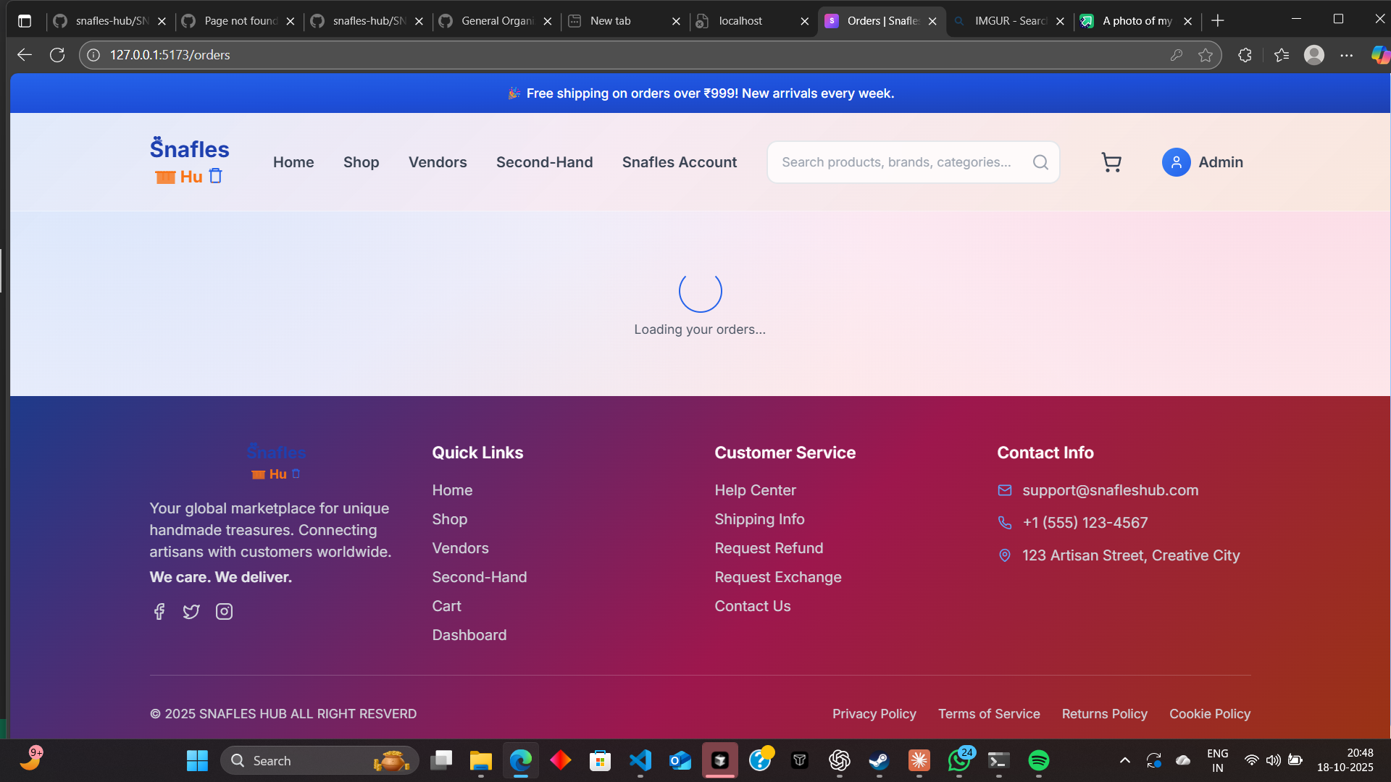
Order Loading Page Crashing and Blinking Continuously
The “Loading Your Order” page is unstable and repeatedly crashes or blinks during the loading process. Instead of smoothly retrieving order information, the page rapidly refreshes or loops, displaying inconsistent or incomplete data. This issue disrupts the checkout experience and creates uncertainty for users waiting for confirmation.
The loading logic needs to be stabilized to prevent repeated renders or infinite reloads. Order data should be fetched once, with a clear loading animation followed by a stable confirmation state. Proper synchronization between frontend rendering and backend order retrieval will ensure a smooth, reliable post-checkout experience.

Slide 20
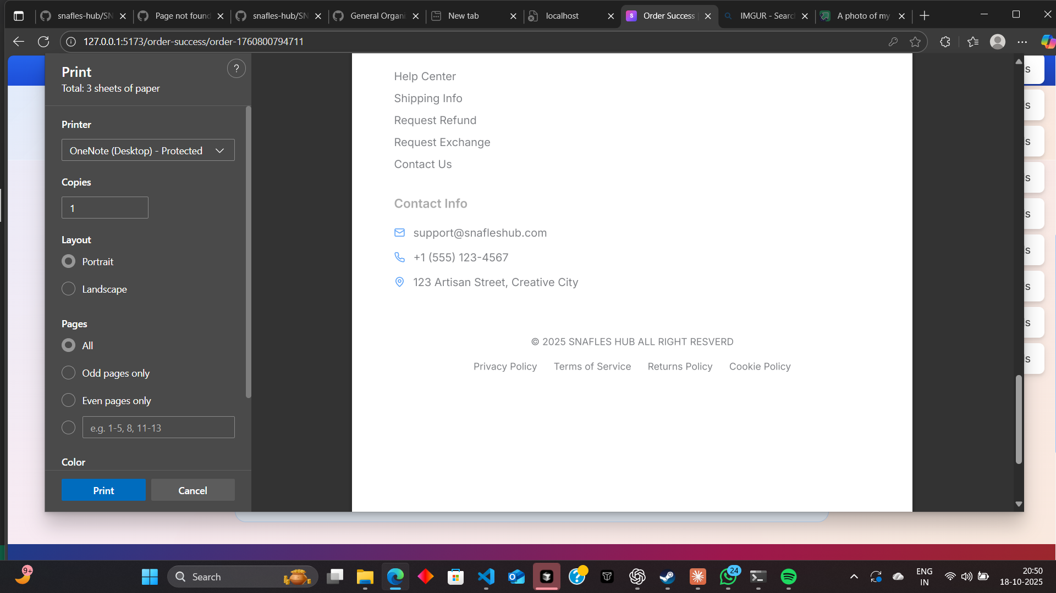
Download Receipt Function Not Working Properly
The “Download Receipt” feature is currently not functioning as intended. When users attempt to download their actual order receipt, the file either fails to generate or downloads an incomplete or placeholder document. In some cases, the option appears clickable but does not initiate any download at all.
This issue prevents customers from accessing valid proof of purchase, which is essential for refunds, exchanges, and record keeping. The receipt generation flow should ensure that the real order data is fetched securely from the backend and formatted correctly before download. Each receipt should include full order details—items, prices, taxes, and date—so users can easily retrieve and store their official order confirmation.

Slide 21
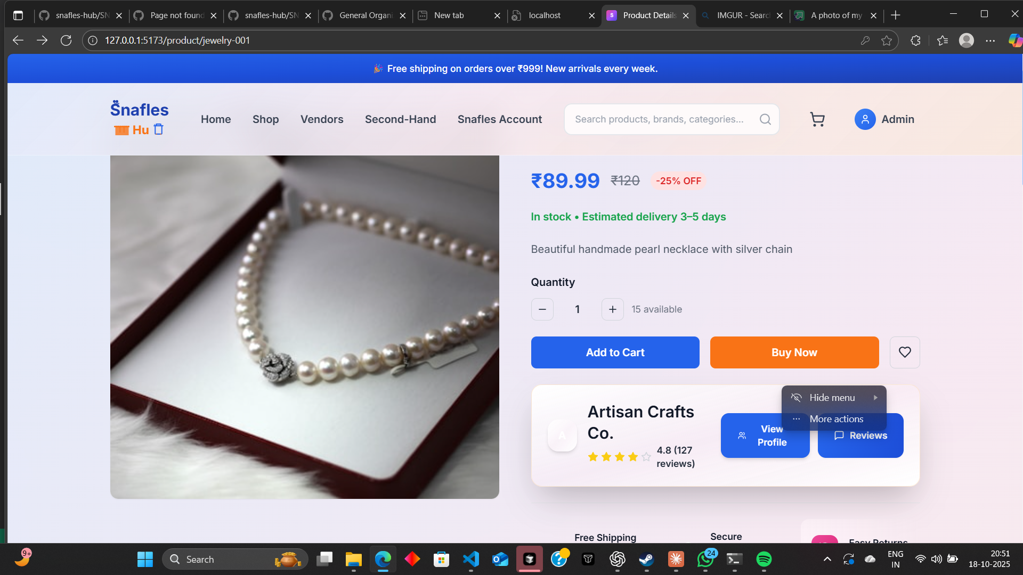
Admin Panel Displaying User Shopping Options
In the admin view, the interface incorrectly shows “Shop” options and buyer-related features that should only be available to regular users. This misalignment causes confusion and disrupts the intended admin workflow. Admin accounts should have access exclusively to administrative tools such as vendor management, product approvals, analytics, and system settings — not consumer-facing functionalities.
The role-based interface logic must be updated to hide user-oriented components when an admin is logged in. Ensuring a clear separation between user and admin interfaces will create a cleaner, more secure, and professional admin experience.

Slide 22
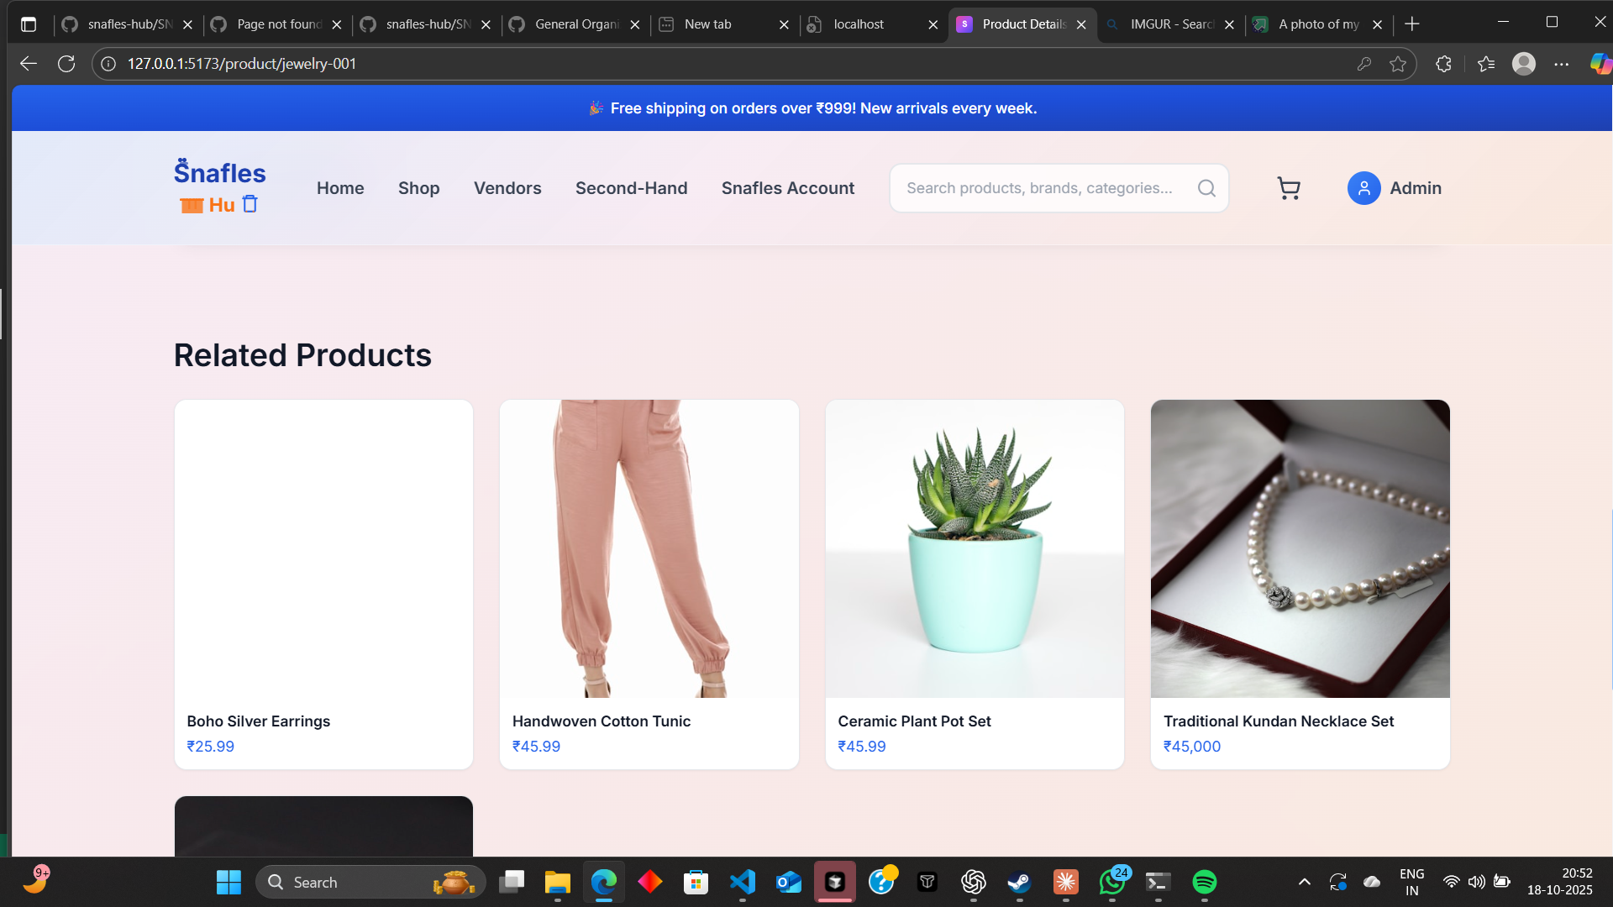
Relative Products Page Not Functioning
The “Relative Products” page is currently broken and not rendering properly. When accessed, the layout either fails to load or displays incomplete data, leaving product cards empty or misaligned. Key features such as product suggestions, related listings, and navigation between items do not function as intended.
The issue disrupts the product discovery experience for users, preventing them from viewing or interacting with related items. The page should load dynamically with accurate product relationships, proper alignment, and smooth transitions. A stable rendering flow is needed to ensure the section works consistently and enhances the overall shopping experience.

Slide 23
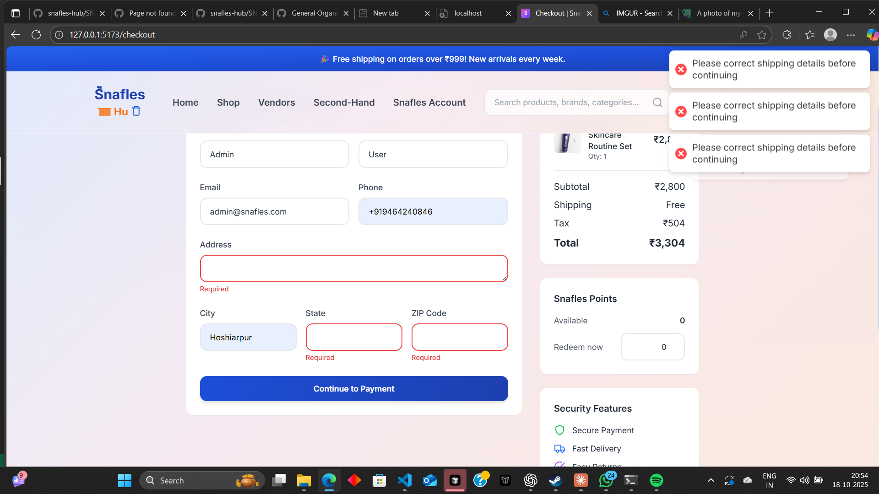
Checkout Form Validation and Error Display Issue
During the checkout process, when users proceed without entering complete details, the system fails to render the error or alert messages properly. The message “Please enter your details on the checkout page” either does not appear at all or appears in an unstyled and poorly positioned manner.
This creates confusion, as users receive no clear feedback on what information is missing or invalid. The checkout validation and error-handling system need to be improved to provide immediate, clear, and visually consistent alerts. Proper inline messages, highlighted fields, and accessible feedback should guide users to complete their information smoothly before proceeding with payment.

Slide 24
Inconsistent Post-Submission State
Following submission, the page does not consistently redirect to a vendor detail or list view. In some cases it remains on the form, creating uncertainty about the outcome. This breaks the expected workflow for admin onboarding and verification.

Slide 25
Thank u

